Slide 1
Artificial Intelligence
Enrique Peláez Ph.D.

Slide 2
Agenda
Management of Uncertainty
  Introduction to Fuzzy Logic
  Applications
Cognitive Maps

Slide 3
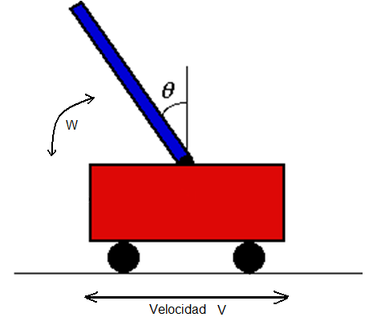
Fuzzy control
Example: The inverted pendulum
Speed S

Slide 4
Fuzzy control
Example: The inverted pendulum
  The problem is to keep a pole on a mobile platform, in equilibrium.
  The platform can move in 2 directions only: Left and right.
  We will need to define (subjectively) what is the speed of the platform: high, low, etc. Hence, we can specify the membership functions of the fuzzy set:
    negative high (light blue)
    negative low (green)
    zero (red)
    positive low (blue)
    positive high (pink)

Slide 5
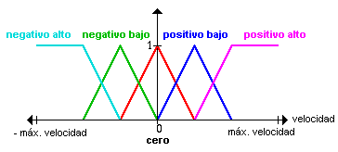
Fuzzy control

Slide 6
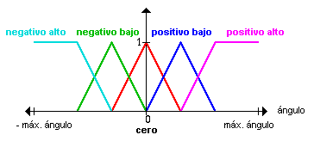
Fuzzy control

Slide 7
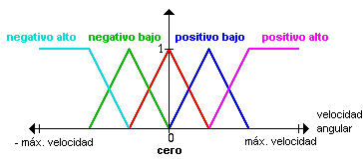
Fuzzy control

Slide 8
Fuzzy control
For example: If the pole is in a central position (the angle is zero) and if it is not moving (the angular speed is zero).
If the pole is in a central position (the angle is zero), but It is moving with low speed in a positive direction, then we have to compensate the movement of the pole, moving the platform in the same direction and a low speed.
Formally:
  If the angle is zero and the angular speed is zero, then the speed is zero.
  If the angle is zero and the angular speed is positive low then the speed is positive low.

Slide 9
Fuzzy control
Summary of all applicable rules:
 | Angle
Angular Speed | Speed | NH | NL | Z | PL | PH
 | NH |  |  | NH
 | NL |  |  | NL | Z
 | Z | NH | NL | Z | PL | PH
 | PL |  | Z | PL
 | PH |  |  | PH

Slide 10
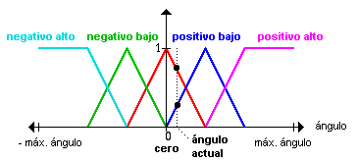
Fuzzy control

Slide 11
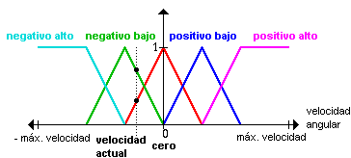
Fuzzy control

Slide 12
Fuzzy control

Slide 13
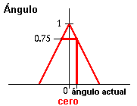
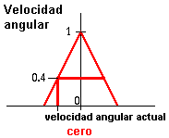
Fuzzy control
If angle is zero and angular speed is zero then speed is zero

Slide 14
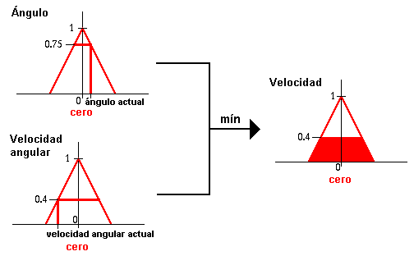
Fuzzy control
If angle is zero and angular speed is zero then speed is zero

Slide 15
Fuzzy control

Slide 16
Fuzzy control
Summary of all applicable rules:
 | Angle
Angular Speed | Speed | NH | NL | Z | PL | PH
 | NH |  |  | NH
 | NL |  |  | NL | Z
 | Z | NH | NL | Z | PL | PH
 | PL |  | Z | PL
 | PH |  |  | PH

Slide 17
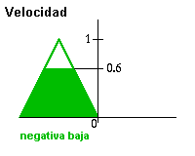
Fuzzy control
If angle is zero and angular speed is NL then speed is NL

Slide 18
Fuzzy control

Slide 19
Fuzzy control
Summary of all applicable rules:
 | Angle
Angular Speed | Speed | NH | NL | Z | PL | PH
 | NH |  |  | NH
 | NL |  |  | NL | Z
 | Z | NH | NL | Z | PL | PH
 | PL |  | Z | PL
 | PH |  |  | PH

Slide 20
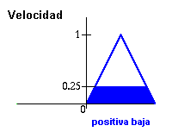
Fuzzy control
If angle is PL and angular speed is zero then speed is PL

Slide 21
Fuzzy control

Slide 22
Fuzzy control
Summary of all applicable rules:
 | Angle
Angular Speed | Speed | NH | NL | Z | PL | PH
 | NH |  |  | NH
 | NL |  |  | NL | Z
 | Z | NH | NL | Z | PL | PH
 | PL |  | Z | PL
 | PH |  |  | PH

Slide 23
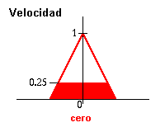
Fuzzy control
If angle is PL and angular speed is NL then speed is zero

Slide 24
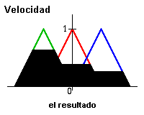
Fuzzy control

Slide 25
Fuzzy control
Velocidad
0.40
Velocidad
cero
Max
0.40
cero

Slide 26
Fuzzy control

Slide 27
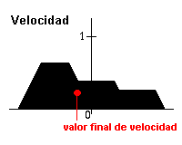
Fuzzy control
For calculating the speed of the platform, we have to determine the most representative value of all participating fuzzy sets. There are several methods for defuzzifying, one of them is to calculate the center of gravity of the fuzzy set.
This process is called “Mamdani Control”

Slide 28
Cognitive Maps

Slide 29
Cognitive Maps
Cognitive Maps were introduced by David Axelrod, (1968) as a method to represent knowledge in politics and social sciences.
They provide a simple method for simbolic and graphical represention of the behavior of events, systems, etc. By representing them as a cause – effect relationship.
To reason with them and predict an effect, we manipulate the “+” and “-” symbols.

Slide 30
Cognitive Maps
C
+
C
1
2
_
_
+
C
C
4
3
_
+
C
5

Slide 31
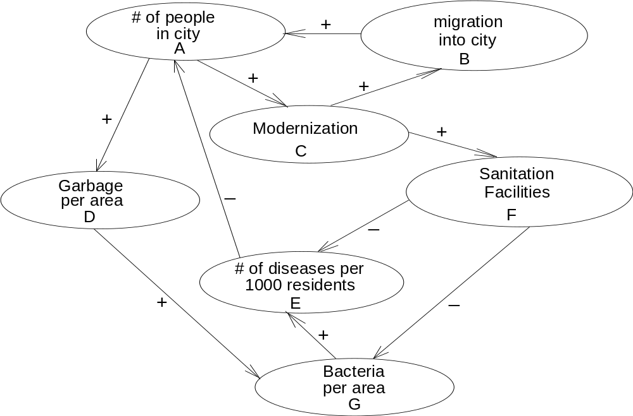
Cognitive Maps

Slide 32
Cognitive Maps
A B C D E F G
A
B
C
D
E
F
G
0
0
+
1
+
1
0
0
0
+
1
0
0
0
0
0
0
0
+
1
0
0
0
+
1
0
Conexión Matrix =
0
0
0
0
0
0
+
1
-
1
0
0
0
0
0
0
0
0
0
0
-
1
0
-
1
0
0
0
0
+
1
0
0

Slide 33
Cognitive Maps
State vector = [C1 C2 ... Cn]
C
☹
C
⎡
⎤
11
1n
[C1 C2 ... Cn]_{new} = [C1 C2 ... Cn]_{old}
Stable = [C1 C2 ... Cn]_{new} = [C1 C2 ... Cn]_{old}
⎢



⎥
C
☹
C
⎢
⎥
⎣
⎦
n1
nn

Slide 34
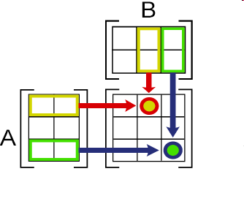
Cognitive Maps
Product of matrix
If A is a m×n matrix and B is a n×p matrix
The product of matrix AB is a m×p matrix
(m rows, p columns):

Slide 35
Cognitive Maps

Slide 36
Cognitive Maps
Concept A Active
[
0 0 0 0 0 0]
1
1st. product
[0 0 1 1 0 0 0]
Thresholding
[
0 1 1 0 0 0]
1
2nd. product
[0 1 1 1 0 1 1]
Thresholding
[
1 1 1 0 1 1]
1
3rd. product
[1 1 1 1 0 1 0]
Thresholding
[
1 1 1 0 1 0]
1
4th. product
[1 1 1 1 -1 1 0]
Thresholding
[
1 1 1 -1 1 0]
1
5th. product
[2 1 1 1 -1 1 0]
Thresholding
[
1 1 1 -1 1 0]
1
Limit vector

Slide 37
Cognitive Maps

